Slide 1
Noticing patterns on the
Multiplication Fact Grid
Noticing patterns: tips

Slide 2
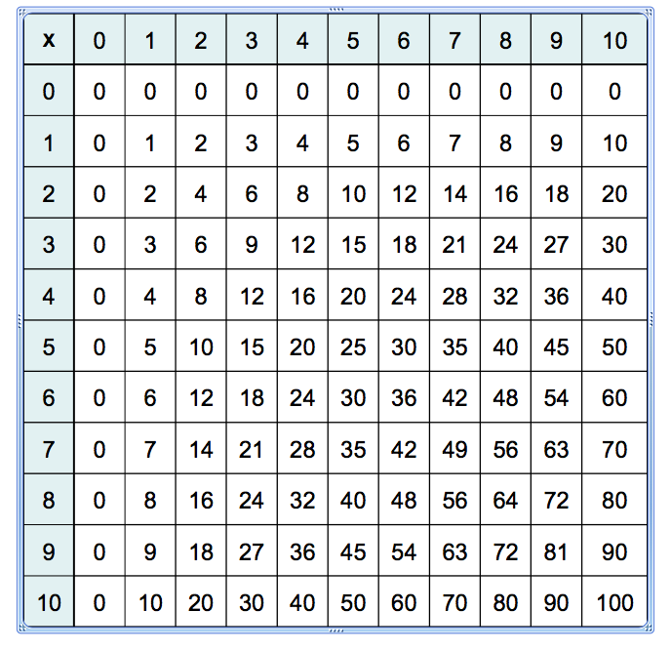
Noticing patterns: tips

Slide 3
Noticing patterns and generalising
Noticing patterns: tips
Patterns students might notice and generalise include:
the sum of the digits in the nines facts is always nine
the sum of the digits in the threes facts
is either 3, 6, or 9
every second multiple of two is a multiple of four.

Slide 4
Teaching tips
Noticing patterns: tips
Noticing patterns can assist students
to generalise rules for divisibility.
For example, if the sum of the digits of a number is 3, 6, or 9 then the number will be divisible by 3, without any remainder.

Slide 5
Teaching tips
Noticing patterns: tips
Recognising patterns and relationships based on place value understanding assist students
to solve multi-digit computations mentally.
For example,
4 × 6 = 24 4 × 600 =2400
4 × 60 = 240 400 × 6 = 2400
40 × 60 = 2400 4000 × 0. 6 = 2400
Ask students to explain how these are alike and different.

