Slide 1
Look , hide and make
Look at the array.
Close your eyes and picture it.
Now make what you saw.

Slide 2
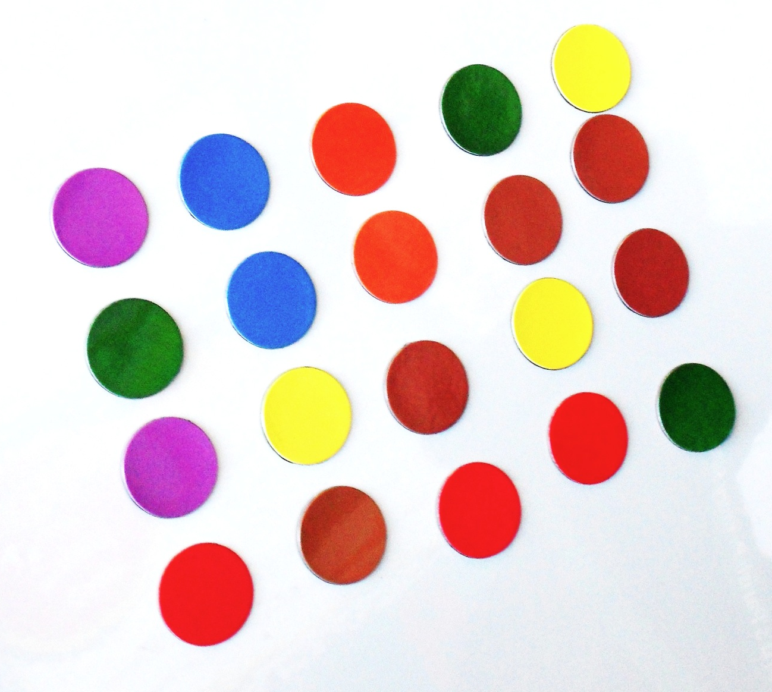
Look , hide and make

Slide 3
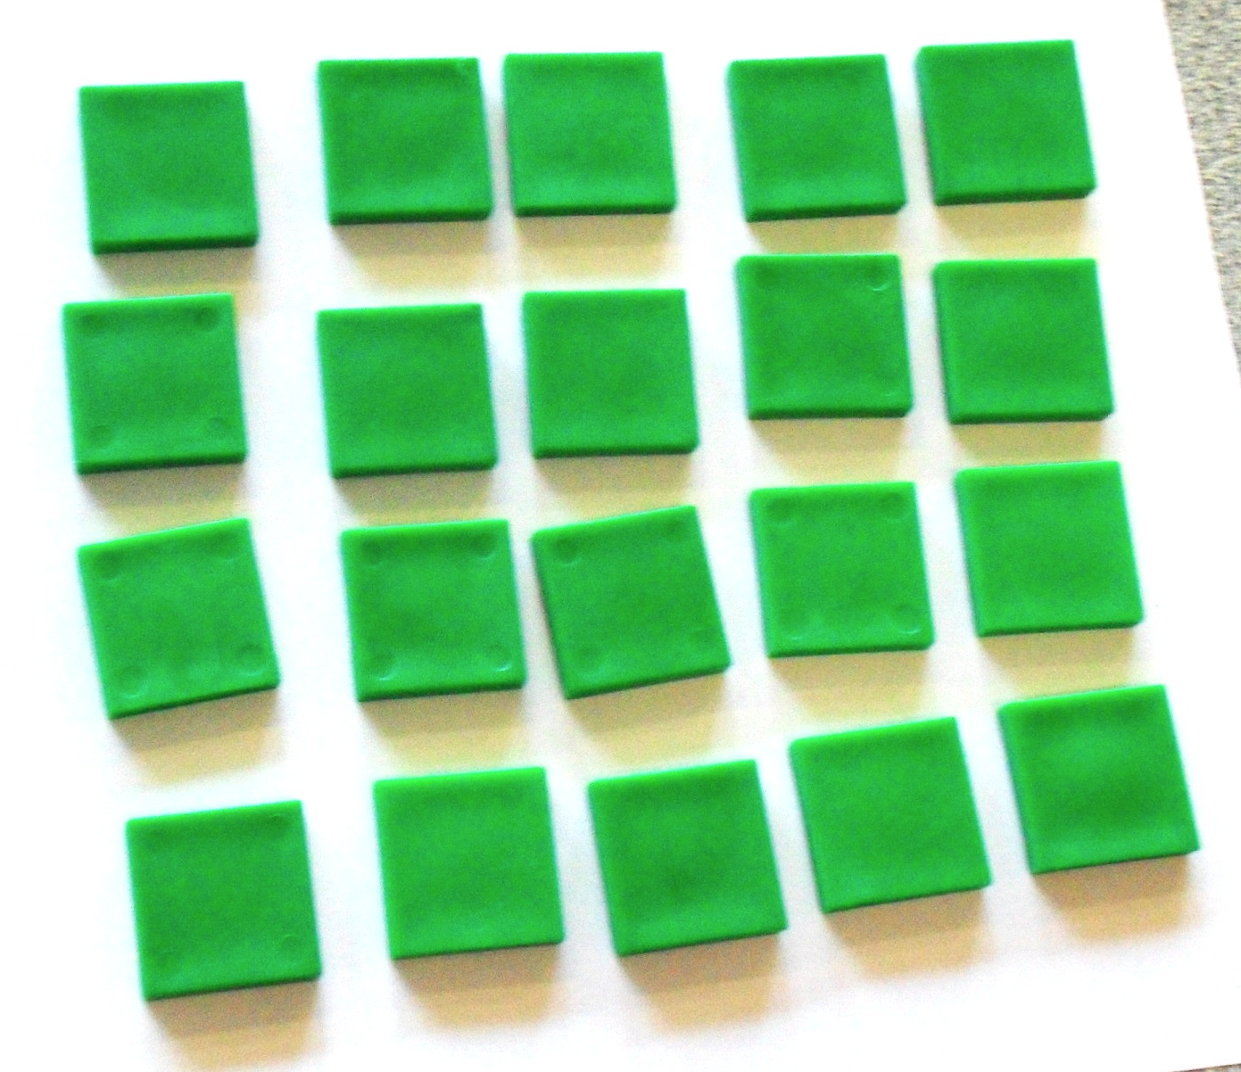
Look , hide and make

Slide 4
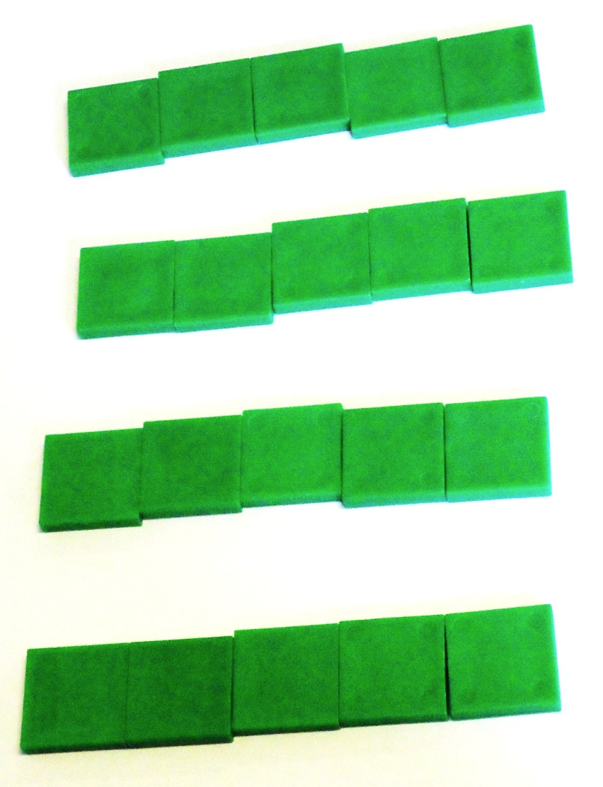
Look , hide and make

Slide 5
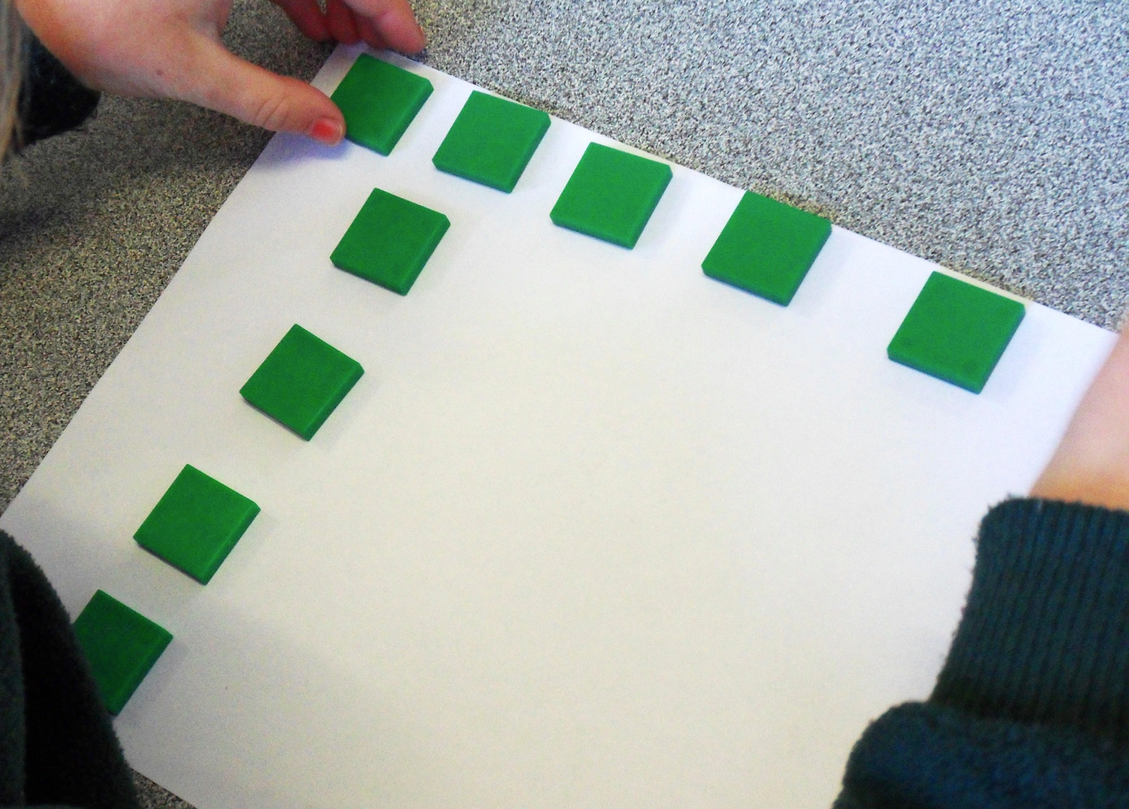
Look , hide and make

Slide 6
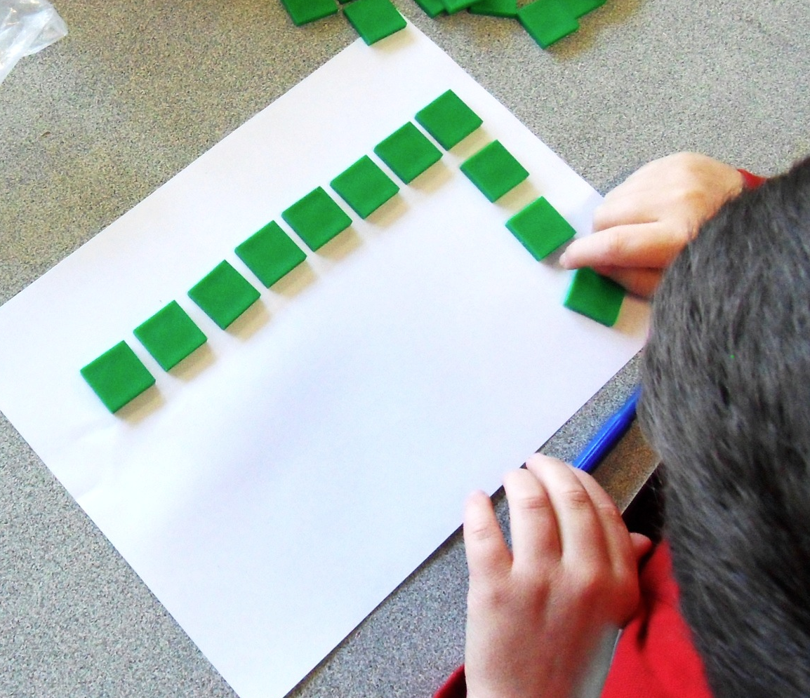
Look , hide and make

