Slide 1
Maths Trails Through the
Queen Victoria Museum and Art
Gallery
Presented by:
Kathleen Hodges

Slide 2
What we will cover:
How we designed our trails
What we gained professionally from the trails
Trialling the trails
What does a trail look like?
How these trails will help you-the teacher
Your turn: designing a trail
Questions

Slide 3
How we designed our trails
What was involved: meeting with Tracey
Fun in the museum
Curriculum consultation: TCF/Australian
Formatting
Editing
Notes:
It all started when Tracey Muir approached the 2011 4th yr cohort to design maths trails through the museum. There were 5 of us from BEd and 2 teachers who were doing their masters. When we met with Tracey she showed us some trails and we discussed what these encompassed. We then split into pairs and a group of 3 and chose which year groups we would focus our trails on. My group consisted of myself, Emma Cooper and Lana Ross and we decided to design 2 trails 1 ECE and 1 primary. From here we met at the museum and wandered through the exhibitions and made notes and decided on questions to put in the trails. We then consulted both the TCF and and Australian curriculums to assist with our rationale and to make sure we were pitching the trails at the right level. Then we had to sit and format and edit the trails which involved a lot on to and froing between us and Tracey. Once we were all happy Tracey then forwarded them onto the musuem for their graphics department to get them ready to be placed on the museum website.

Slide 4
What we got professionally from the trails
The chance to look at the whole maths curriculum.
“I enjoyed this experience as I worked with two pre-service teachers who are Primary trained (I am Early childhood) and I found it invaluable to hear their ideas and discuss maths problems with them that I wouldn’t generally do in a classroom” (Lana Ross)
Notes:
This was something that the 3 of us all gained from this experience. For Emma and myself it reminded us of what students had previously learnt. It gave us all a chance to look at the curriculum as a whole rather than just one grade group.

Slide 5
What we got professionally from the trails
Maths is everywhere
“Creating these maths trails has provided me with a better understanding of how maths is all around us and I am able to model this for my students.” (Lana Ross teacher, Cairns Qld).
Notes:
All too often we forget than maths is all around us. By participating in this project we were reminded of this. We only need to look around this room and we can find maths. Who can point out some maths in this room? Eg: measurement, angles, shape/geometry.

Slide 6
Trialling the trails
School holiday program
6 children aged between 6 & 8
How long did it take?
Notes:
Late last year we were approached by the museum to trial a maths trail during the museum’s school holiday program. We decided that we would use the ECE trail. We had 6 children aged between 6 and 8 and as they didn’t know each other or us Emma and I decided that we would keep the 6 children together as one group. Now we stretched the trail out to 2 hours only because that was the allotted time for our workshop. Also as we had great converstaion happening between the children and ourselves we did not want to rush them. The actual time frame allotted for the trails is approx 40- 60 minutes. It will all depend on how much time you have to spend at the museum and the make up of your class.

Slide 7
What do they look like?
Notes:
In your pack you have a page from the ECE trail. This shows you how it is formatted and the types of questions and tasks the students will have to perform. Also you will see from what I have up on the screen that they are quite elaborate in design with photos to assist the students. A map is also attached and we have 2 versions of the trails- 1 for the students and 1 as teacher/adult assistance notes. I would strongly recommend that before commencement that you endeavour to chat to your adult helpers just in case there is something that they are unsure of. This will just save time during the trails rather than having adults and or students approaching you .

Slide 8
How these trails will help you
Practical resource
“I am currently teaching middle school maths and am really enjoying the content and the ability
to make maths to be more than a textbook for my students” (Emma Cooper, teacher Katherine, NT).
Collaboration
“At the moment I am looking at doing maths trails with my year 8's through a relationship I'm currently trying to set up with a school in Hobart, using computers etc” (Emma Cooper, teacher Katherine, NT).
Notes:
Maths trails are a practical resource which assists in students gaining a conceptual undertanding of maths rather than it being just something they have to learn at school as a process. As you can see from the quote from Emma she is endeavouring to collaborate with a school in Hobart while she is teaching in the Northern Territoty. However, collaboration could be as simple as buddy classes or grade teams such as 3/4’s or 1/2’s.

Slide 9
When trails will be available
Online at: www.qvmag.tas.gov.au at the end of May
OR
Email:
Tammy.Edmunds@launceston.tas.gov.au
Notes:
Hoping to have a “launch” of all the trails at the end of may to which schools will be invited.

Slide 10
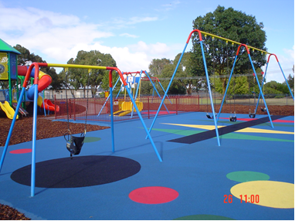
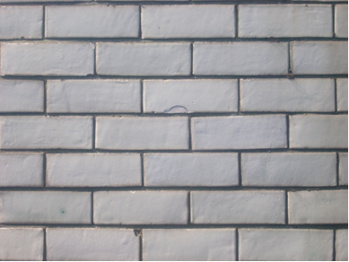
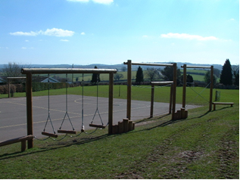
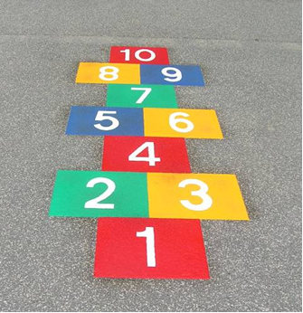
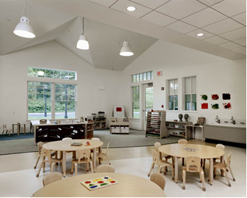
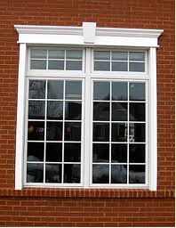
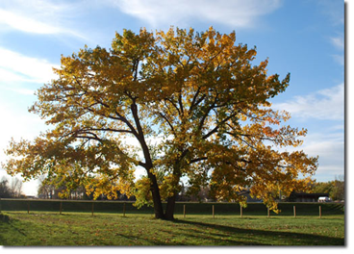
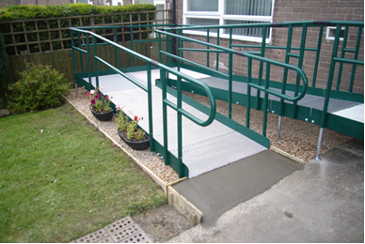
Your turn: designing a trail
Notes:
When designing a trail it does not have to be as elaborate as the ones we have designed for the museum. I designed one last year for a grade 5/6 class for an angles unit I was doing. As I didn’t have a lot of time to spare due to timetable constraints my trail was just text with no photos. This trail was incredibl7y successful.

Slide 11
Questions????

