Slide 1
The potential of posing more challenging tasks and ways of supporting students to engage in such tasks (Years K-10)
Peter Sullivan

Slide 2
Abstract
While most students want to work on more challenging mathematics, there are still some who require substantial support.
The workshop will explore examples of tasks with low "floors" but high "ceilings" that allow all students to engage with the tasks at some level, but which can be extended productively for those who are ready.
A particular lesson structure that supports the work of all students on such tasks will be presented and discussed.

Slide 3
Overview
A rationale for the proposition
Some suggestions of (a few) lessons
Creating your own

Slide 4
Which of these are your top two priorities, that students …
Enjoy the mathematics they are learning
See the usefulness the mathematics to them
Be able to interpret the world mathematically
See the connection between mathematics learning and their future study and career options
Know that they can learn
Know that they can learn mathematics
Know that they can get smarter by trying hard

Slide 5
For students to learn, two sets of factors must align
The first set of factors include that the:
  students have the requisite prior knowledge;
  curriculum is relevant to them;
  classroom tasks match their expectations;
  classroom tasks help them make connections
  pedagogies use their knowledge and experience;
  assessment regimes measure their learning.

Slide 6
The second set of factors relates to
whether the students
  are motivated to learn
  see participation in schooling as creating opportunities
  are willing to persist
  connect effort and success

Slide 7
Where does the idea of “challenge” come from?
Guidelines for school and system improvement (see, e.g., City, Elmore, Fiarman, & Teitel, 2009)
The motivation literature (Middleton, 1995; 1999).
Sets of teaching principles
  Principles of Learning and Teaching, 2009
  Productive Pedagogies, 2009

Slide 8
Why challenge?
Learning will be more robust if students connect ideas together for themselves, and determine their own strategies for solving problems, rather than following instructions they have been given.
Both connecting ideas together and formulating their own strategies is more complex than other approaches and is therefore more challenging.
It is potentially productive if students are willing to take up such challenges.

Slide 9
This connects to “mindsets”
Dweck (2000) categorized students’ approaches in terms of whether they hold either growth mindset or fixed mindset

Slide 10
Students with growth mindset:
Believe they can get smarter by trying hard
Such students
  tend to have a resilient response to failure;
  remain focused on mastering skills and knowledge even when challenged;
  do not see failure as an indictment on themselves; and
  believe that effort leads to success.

Slide 11
Students with fixed mindset:
Believe they are as smart as they will even get
Such students
  seek success but mainly on tasks with which they are familiar;
  avoid or give up quickly on challenging tasks;
  derive their perception of ability from their capacity to attract recognition.

Slide 12
Teachers can change mindsets
This connects to
  the things we affirm (effort, persistence, co-operation, learning from others, flexible thinking)
  the way we affirm
    You did not give up even though you were stuck
    You tried something different
    You tried to find more than one answer
  the types of tasks we pose

Slide 13
Challenging tasks require students to
plan their approach, especially sequencing more than one step;
process multiple pieces of information, with an expectation that they make connections between those pieces, and see concepts in new ways;
choose their own strategies, goals, and level of accessing the task;
spend time on the task and record their thinking;
explain their strategies and justify their thinking to the teacher and other students.

Slide 14
Getting started
“zone of confusion”
“four before me”
  representing what the task is asking in a different way such as drawing a cartoon or a diagram, rewriting the question …
  choosing a different approach to the task, which includes rereading the question, making a guess at the answer, working backwards …
  asking a peer for a hint on how to get started
  looking at the recent pages in the workbook or textbook for examples.

Slide 15
From some current research

Slide 16
17. I know I have between 15 and 25 apples. When they are put into groups of 6 there are 2 apples left over. How many apples do I have?
ANSWER | PRE -TEST | POST- TEST
It is not possible to tell
18
20
22
Total

Slide 17
17. I know I have between 15 and 25 apples. When they are put into groups of 6 there are 2 apples left over. How many apples do I have?
ANSWER | PRE -TEST | POST- TEST
✘ It is not possible to tell | 20% | 14%
✘ 18 | 25% | 22%
✔ 20 | 40% | 48%
✘ 22 | 15% | 16%
Total | 100% | 100%

Slide 18
 | PRE- TEST | POST- TEST
I am very confident that I answered the apples question correctly | 26% | 34%
I am quite confident that I answered the apples question correctly | 53% | 52%
I am not confident that I answered the apples question correctly | 21% | 14%
TOTAL | 100% | 100%

Slide 19
 | PRE- TEST | POST -TEST
I prefer tasks I work on in class to be much harder than the apples question | 29% | 34%
I prefer tasks I work on in class to be about as hard as the apples question | 56% | 55%
I prefer tasks I work on in class to be much easier than the apples question | 15% | 12%
TOTAL | 100% | 100%

Slide 20
 | PRE -TEST | POST -TEST
I prefer to work out tasks like the apples question for myself | 39% | 41%
I prefer to work on tasks like the apples question with other students | 44% | 47%
I prefer to be told what to do by the teacher | 17% | 12%
TOTAL | 100% | 100%

Slide 21
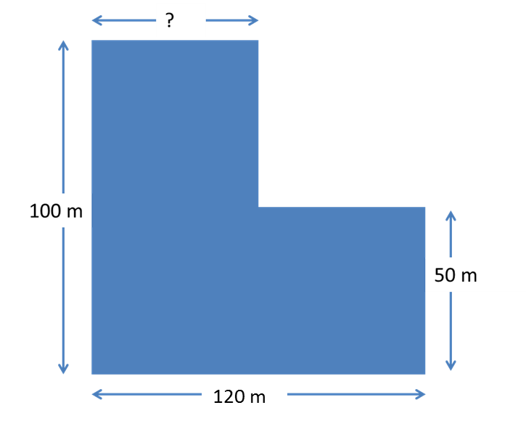
This is a paddock in the shape of an L. The area is 1 hectare. How many metres wide is the top part of the L? (A square 100 m x 100 m has an area of 1 hectare) (Diagram not drawn to scale)

Slide 22
16. This is a paddock in the shape of an L. The area is 1 hectare. How many metres wide is the top part of the L? (A square 100 m x 100 m has an area of 1 hectare) (Diagram not drawn to scale)
Pre -Test | 4 % correct
Post-Test | 21 % correct

Slide 23
Answer | Pre-Test | Post-Test
I am very confident that I answered the paddock question correctly | 14% | 15%
I am quite confident that I answered the paddock question correctly | 51% | 53%
I am not confident that I answered the paddock question correctly | 34% | 32%
 | 100% | 100%

Slide 24
Answer | Pre-Test | Post-Test
I prefer tasks I work on in class to be much harder than the paddock question | 16% | 16%
I prefer tasks I work on in class to be about as hard as the paddock question | 62% | 61%
I prefer tasks I work on in class to be much easier than the paddock question | 22% | 23%
 | 100% | 100%

Slide 25
Answer | Pre-Test | Post-Test
I prefer to work out tasks like the paddock question for myself | 31% | 32%
I prefer to work on tasks like the paddock question with other students | 54% | 58%
I prefer to be told what to do by the teacher | 15% | 11%
 | 100% | 100%

Slide 26
An illustrative lesson

Slide 27
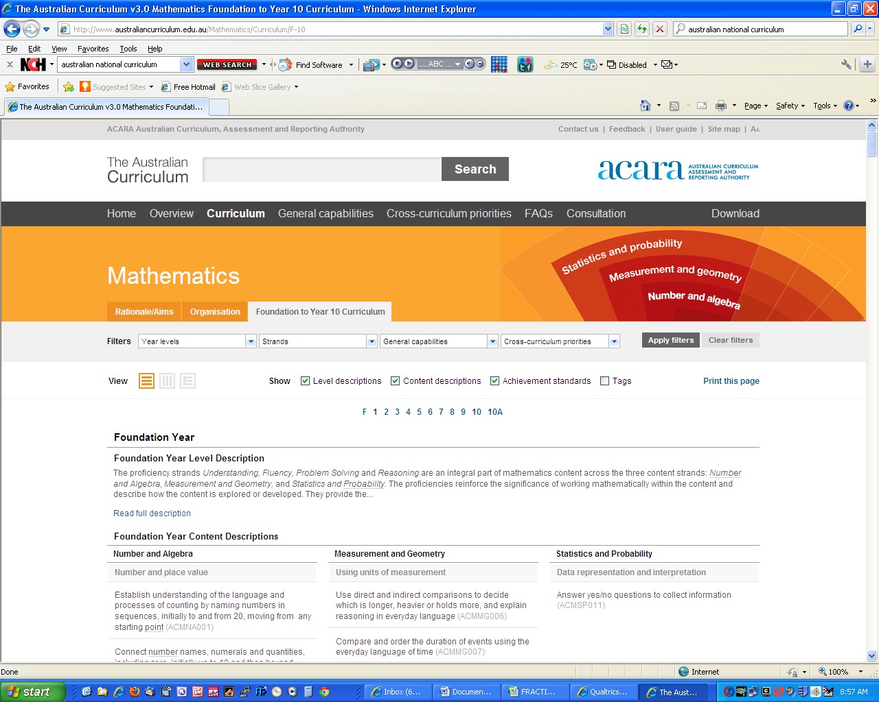

Slide 28
Year 5
Money and financial mathematics
Create simple financial plans (ACMNA106)
Number and place value
Use estimation and rounding to check the reasonableness of answers to calculations (ACMNA099)
Use efficient mental and written strategies and apply appropriate digital technologies to solve problems (ACMNA291)

Slide 29
Year 6
Money and financial mathematics
Investigate and calculate percentage discounts of 10%, 25% and 50% on sale items, with and without digital technologies (ACMNA132)
Number and place value
Select and apply efficient mental and written strategies and appropriate digital technologies to solve problems involving all four operations with whole numbers (ACMNA123)

Slide 30
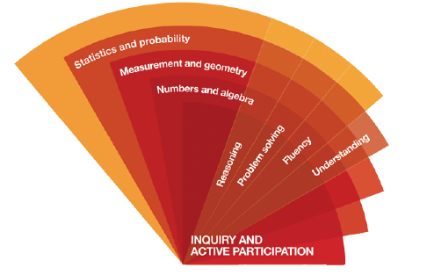
How is this represented in the AC?

Slide 31
At year 5:
Understanding includes making connections between representations …
Fluency includes … using estimation to check the reasonableness of answers to calculations
Problem Solving includes formulating and solving authentic problems using whole numbers and creating financial plans
Reasoning includes investigating strategies to perform calculations …

Slide 32
At year 6:
Understanding includes … making reasonable estimations
Fluency includes … calculating simple percentages
Problem Solving includes formulating and solving authentic problems
Reasoning includes explaining mental strategies for performing calculations,

Slide 33
In preparation for the lesson, please read the rubric
I will ask you to self assess
Hint: Write neatly

Slide 34
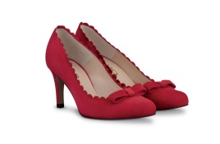
Jenny and Carly go shopping for shoes. Jenny chooses one pair for $110 and another for $100. Carly chooses a pair that cost $160.
When they go to pay, the assistant says that there is a sale on, and they get 3 pairs of shoes for the price of 2 pairs.
Give two options for how much Jenny and Carly should each pay?
Explain which option is fairer.
Special offer
THREE PAIRS FOR THE PRICE OF TWO
The free pair is the cheapest one
Special offer
THREE PAIRS FOR THE PRICE OF TWO
The free pair is the cheapest one

Slide 35
Representing the situation

Slide 36
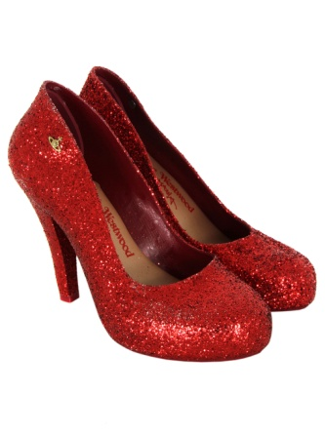
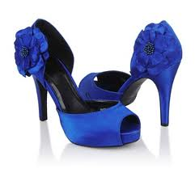
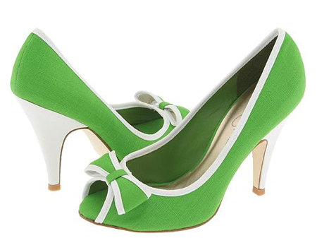
$160
$110
$100
Carly
Jenny

Slide 37
$160
$110
$100
This pair is free
Carly
Jenny

Slide 38
The sharing option
They have to pay $270
So Jenny pays $180 and Carly pays $90

Slide 39
The Saving Option
They save $100
If they share the saving equally,
  Then Jenny pays $210 - $50 = $160
  Carly pays $160 - $50 = $110

Slide 40
A Consolidating Task
Jenny and Carly go shopping for shoes. Jenny chooses one pair for $110 and another for $100. Carly chooses a pair that cost $60. When they go to pay, the assistant says that there is a sale on, and they get 3 pairs of shoes for the price of 2 pairs (the cheapest pair becomes free). Give two options for how much Jenny and Carly should each pay? Explain which is the fairer.
Explain in what ways the fairer solution depends on the cost of Carly’s shoes.

Slide 41
Enabling Prompt:
Kerry and Kathy are twins and can share shoes. Kerry chooses one pair for $20. Kathy chooses a pair that costs $40.
How much should they each pay?

Slide 42

An extending task
Bert, Bob and Bill are shopping for shirts.
Bill chooses a shirt costing $30 and another for $50.
Bob chooses one shirt for $60.
Bert chooses one shirt for $30 and another for $40.
When they go to pay, the assistant says that there is a sale on, and they get 5 shirts for the price of 3.
Give two options for how much Bill and Bert and Bob should each pay? Explain which is the fairest.
Today only
FIVE SHIRTS FOR THE PRICE OF THREE
The free ties are the cheaper ones

Slide 43
What would be the point of asking a question like that?
What might make it difficult?

Slide 44
Using the Rubric
Assess yourself on your answer(s) to the shoes question

Slide 45
How might you adapt the shoes task if you are teaching grade 2?

Slide 46
97 + 92 + 3
3 + 3 + 3 + 17 + 17 + 17
3 + 4 + 6 + 7
1 + 2 + 3 + 19 + 18 + 17
998 + 157 + 2
11 + 11 + 12 + 19 + 19 + 19
What advice would you give to someone about working out answers like these in your head?

Slide 47
For the students:
If you are given the surface area of a rectangular prism, you are able to work out what the prism might look like.

Slide 48
Surface area = 22
A rectangular prism is made from cubes.
It has a surface area of 22 square units.
Draw what the rectangular prism might look like?

Slide 49
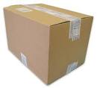
Consolidating
The surface area of a closed rectangular prism is 46 cm².
What might be the dimensions of the prism?

Slide 50
Introductory task:
What is the surface area and volume of a cube that is 2 cm × 2 cm × 2 cm?

Slide 51
Enabling prompt:
Arrange a small number of cubes into a rectangular prism, then calculate the volume and surface area.

Slide 52
Extending prompt:
The surface area of a closed rectangular prism is 94 cm².
What might be the dimensions of the prism?

Slide 53
A probability task

Slide 54
First do this task
On a train, the probability that a passenger has a backpack is 0.6, and the probability that a passenger as an MP3 player is 0.7.
How many passengers might be on the train?
How many passengers might have both a backpack and an MP3 player?
What is the range of possible answers for this?
Represent each of your solutions in two different ways.

Slide 55
Starting from the content descriptions

Slide 56
Reading the content description(s) to identify the key ideas
Represent events in two-way tables and Venn diagrams and solve related problems (ACMSP292)

Slide 57
Reading the content description(s) to identify the key ideas
Represent events in two-way tables and Venn diagrams and solve related problems (ACMSP292)

Slide 58
Reading the content description(s) to identify the key ideas
Represent events in two-way tables and Venn diagrams and solve related problems (ACMSP292)

Slide 59
Reading the content description(s) to identify the key ideas
Represent events in two-way tables and Venn diagrams and solve related problems (ACMSP292)

Slide 60
Reading the content description(s) to identify the key ideas
Represent events in two-way tables and Venn diagrams and solve related problems (ACMSP292)

Slide 61
What would we say to the students are the learning goals/intentions?
Devising for ourselves different ways of representing categorical data

Slide 62
Assume we have 10 people
1 | 2 | 3 | 4 | 5 | 6 | 7 | 8 | 9 | 10
BP | BP | BP | BP | BP | BP
MP3 | MP3 | MP3 | MP3 | MP3 | MP3 | MP3

Slide 63
Assume we have 10 people
1 | 2 | 3 | 4 | 5 | 6 | 7 | 8 | 9 | 10
BP | BP | BP | BP | BP | BP
 | MP3 | MP3 | MP3 | MP3 | MP3 | MP3 | MP3

Slide 64
Assume we have 10 people
1 | 2 | 3 | 4 | 5 | 6 | 7 | 8 | 9 | 10
BP | BP | BP | BP | BP | BP
 |  | MP3 | MP3 | MP3 | MP3 | MP3 | MP3 | MP3

Slide 65
Assume we have 10 people
1 | 2 | 3 | 4 | 5 | 6 | 7 | 8 | 9 | 10
BP | BP | BP | BP | BP | BP
 |  |  | MP3 | MP3 | MP3 | MP3 | MP3 | MP3 | MP3

Slide 66
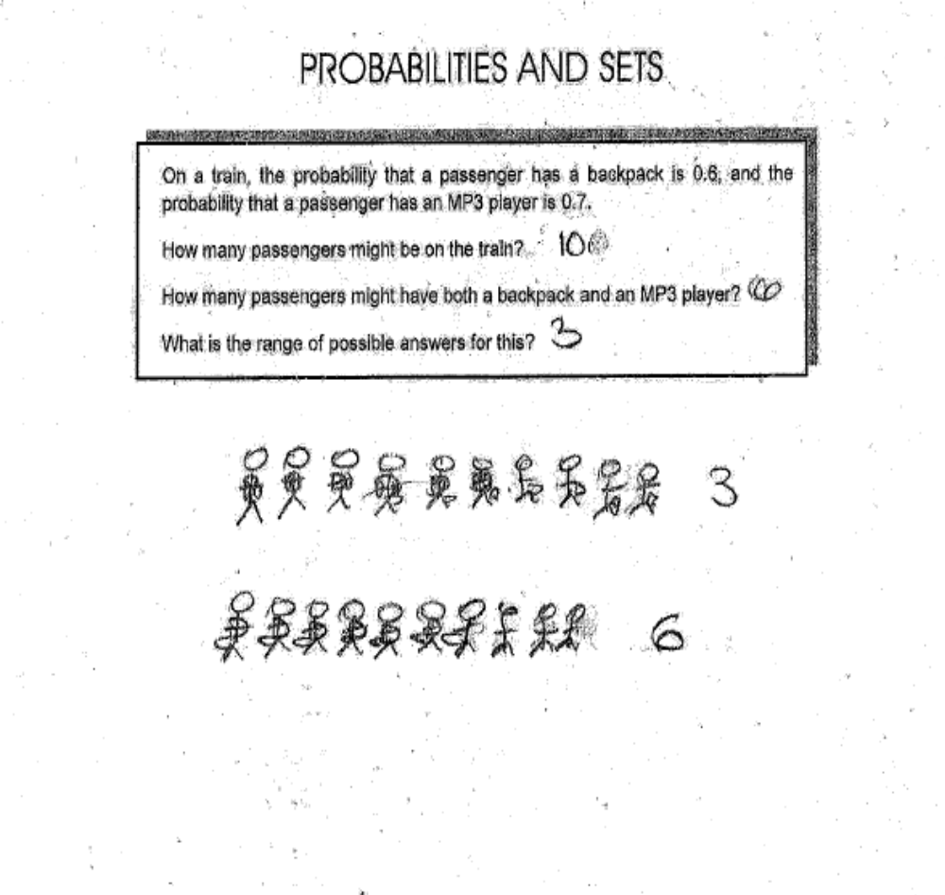

Slide 67
Two way tables
 | back pack | No back pack
MP3 player | 3 | 4
No MP3 player | 3 | 0

Slide 68
Venn diagrams
Back pack
MP3 player
3
4
3
0

Slide 69
What about the students who cannot get started?
An enabling prompt
On a train, there are 10 people.
Six of the people have a backpack, and 7 of the people have an MP3 player.
How many people might have both a backpack and an MP3 player?
What is the smallest possible answer for this?
What is the largest possible answer?

Slide 70
What are enabling prompts?
Enabling prompts can involve slightly varying an aspect of the task demand, such as
  the form of representation,
  the size of the numbers, or
  the number of steps,
so that a student experiencing difficulty, if successful, can proceed with the original task.
This approach can be contrasted with the more common requirement that such students
  listen to additional explanations; or
  pursue goals substantially different from the rest of the class.

Slide 71
An extending prompt
On a train, the probability that a passenger has a backpack is 2/3, and the probability that a passenger has an MP3 player is 2/7.How many passengers might be on the train? How many passengers might have both a backpack and an MP3 player? What is the range of possible answers for this?
Represent each of your solutions in two different ways.

Slide 72
Thinking about what comes next

Slide 73
A consolidating task
On a train, the probability that a passenger has a backpack is 0.65, and the probability that a passenger as an MP3 player is 0.57.
How many passengers might be on the train?
What is the maximum and minimum number of possibilities for people who have both a backpack and an MP3 player?
Represent each of your solutions in two different ways.

Slide 74
Missing number multiplication

Slide 75
Our goal
Sometimes solving multiplication and division problems is about finding patterns.
In this case look for numbers that when multiplied have an answer that ends in 0.

Slide 76
Missing digit
This number has a digit missing
__ 4
What might be the number?

Slide 77
The question
I did a multiplication question correctly for homework, but my printer ran out of ink. I remember it looked like
2 _ x 3 _ = _ _ 0
What might be the digits that did not print? (Give as many answers as you can)

Slide 78
If you are stuck
What might be the missing digits
__ × __ = __ 0

Slide 79
If you are finished
What might be the missing digits?
_ x _ 0 x 3 _ = _ _ 0

Slide 80
Now do this
I did a multiplication question correctly for homework, but my printer ran out of ink. I remember it looked like
1 __ × 4 __ = __ __ 2
What might be the digits that that did not print?
(give as many answers as you can)

Slide 81
We said our goal was …
Sometimes solving multiplication and division problems is about finding patterns.
In this case look for numbers that when multiplied have an answer that ends in 0.

Slide 83
Surface area = 22
A rectangular prism is made from cubes.
It has a surface area of 22 square units.
Draw what the rectangular prism might look like?

Slide 84
For the students:
If you are given the surface area of a rectangular prism, you are able to work out what the prism might look like.

Slide 85
Introductory task:
What is the surface area and volume of a cube that is 2 cm × 2 cm × 2 cm?

Slide 86
Enabling prompt:
Arrange a small number of cubes into a rectangular prism, then calculate the volume and surface area.

Slide 87
Extending prompt:
The surface area of a closed rectangular prism is 94 cm².
What might be the dimensions of the prism?

Slide 88
The surface area of a closed rectangular prism is 46 cm².
What might be the dimensions of the prism?

Slide 89
The notion of classroom culture
Rollard (2012) concluded from the meta analysis that classrooms in which teachers actively support the learning of the students promote high achievement and effort. We interpret this to refer to ways that teachers can support students in engaging with the challenge of the task, and in maintaining this challenge as distinct from minimising it.

Slide 90
Some elements of this active support :
the identification of tasks that are appropriately challenging for most students;
the provision of preliminary experiences that are pre-requisite for students to engage with the tasks but which do not detract from the challenge of the task;
the structuring of lessons including differentiating the experience through the use of enabling and extending prompts for those students who cannot proceed with the task or those who complete the task quickly;

Slide 91
the potential of consolidating tasks, which are similar in structure and complexity to the original task, with which all students can engage even if they have not been successful on the original task;
the effective conduct of class reviews which draw on students’ solutions to promote discussions of similarities and differences;
holistic and descriptive forms of assessment that are to some extent self referential for the student and which minimise the competitive aspects; and
finding a balance between individual thinking time and collaborative group work on tasks.

Slide 92
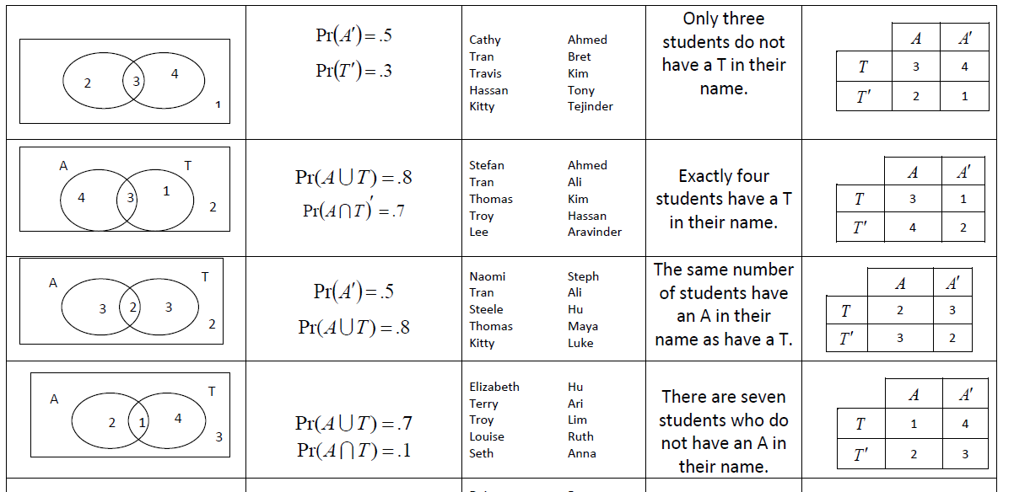
Task: Representing probability in different ways

Slide 93


First
A
T
A’
A T
A T

Slide 94
Thinking about the lesson structure
Launch
Explore
Summarise
In this view, the sequence
  Launch (without telling)
  Explore (for themselves)
  Summarise (drawing on the
  learning of the students)
… is cyclical and might happen more than once in a lesson (or learning sequence)

Slide 95
Choose one of the following tasks
Work through it
Write
  Goal/learning intention
  Introduction (if needed)
  Enabling prompt
  Extending prompt
  Consolidating task

Slide 96
The tasks
I am thinking of a number. There is a 7 in the tens place. The hundreds place is more than the units place. What might be the number?
If Jim can paint his house in 4 days, and Sally (his wife) can paint the house in 5 days, how long will it take if the both paint together?
A number when rounded is 5.8. What might be the number?

Slide 97
This is a design of paths in a rectangular garden. I know that one of the straight lines is 10m long (but I forget which one). I know that at least one of the angles is 30⁰. What might be the perimeter of the garden? (there is more than 1 answer)

Slide 98
Draw a quadrilateral that has one reflex angle, one obtuse angle and two acute angles.
Write your name using a single line that is 1 m long.

